Slide 1
VUNO EYE TEAM – graphical abstract
REFUGE2 @ MICCAI 2020

Slide 2
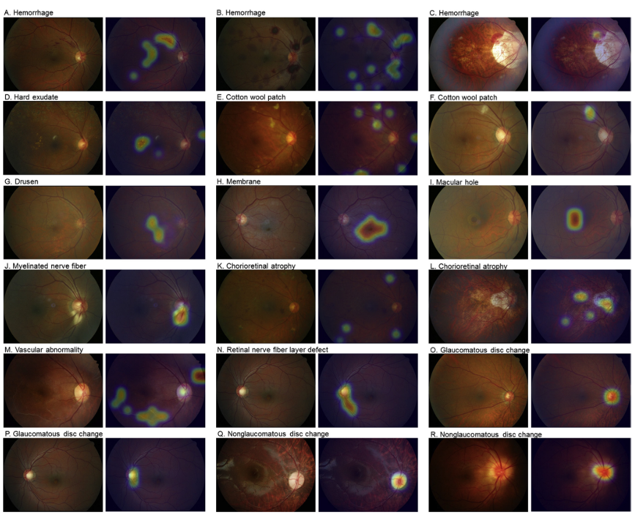
Sub-Challenge 1 | Glaucoma classification
Glaucoma
▲Finding networks ^{[1]} used in the sub-challenge
▲ Network architecture for glaucoma classification
[1] Son, Jaemin, et al. "Development and validation of deep learning models for screening multiple abnormal findings in retinal fundus images." Ophthalmology 127.1 (2020): 85-94.

Slide 3
Sub-Challenge 2 | Cup/Disc segmentation
▲ Network architecture for cup/disc segmentation using vessel segmentation network^{[2]}
[2] Son, Jaemin, Sang Jun Park, and Kyu-Hwan Jung. "Towards accurate segmentation of retinal vessels and the optic disc in fundoscopic images with generative adversarial networks." Journal of digital imaging 32.3 (2019): 499-512.

Slide 4
Sub-Challenge 3 | Fovea Localization
▲ Network architecture for fovea localization using vessel segmentation network^{[2]}
[2] Son, Jaemin, Sang Jun Park, and Kyu-Hwan Jung. "Towards accurate segmentation of retinal vessels and the optic disc in fundoscopic images with generative adversarial networks." Journal of digital imaging 32.3 (2019): 499-512.

Slide 5
Thank you!
Contact woalsdnd@vuno.co for any questions!
T 02.515.6646
E hello@vuno.co
H www.vuno.co

